Slide 1
Azure App Service

Slide 2
Agenda
Web App creation
Language Support
Deployment
Source Control Integration
Scale
Web Jobs
Site Slots
Traffic Manager
Backup
Hybrid Connections
Redis Cache

Slide 3
Visual Studio 2015 Offerings
Visual Studio 2013
PROFESSIONAL WITH MSDN
PREMIUM WITH MSDN
ULTIMATE WITH MSDN
MSDN PLATFORMS
TEST PROFESSIONAL WITH MSDN
Visual Studio 2015
PROFESSIONAL WITH MSDN
ENTERPRISE WITH MSDN
MSDN PLATFORMS
TEST PROFESSIONAL WITH MSDN
Notes:
This year, we collapsed the Visual Studio Premium and Ultimate products into Visual Studio Enterprise. If you have always wanted to be able to use one of the cool features in Ultimate, hopefully now you can. And, if you’ve always had Ultimate, not it’s just a lot cheaper!

Slide 4
Visual Studio 2015 Enterprise
IntelliTrace
Code Maps
Web & Load Performance Testing
UML 2.0 Compliant Diagrams
Layer & Dependency Diagrams
Code Metrics
Coded UI Testing
Code Clone Analysis
Performance & Diagnostics Hub
Task Suspend/Resume
Release Management
IntelliTest
Microsoft Test Manager
$150 monthly Azure credits
Notes:
While there are changes to several of the features, during our demonstrations and within the hands-on labs, we’ll be highlighting a few of those features that are brand new or have undergone significant changes.

Slide 5
VSO & Team Foundation Server 2015
Kanban Board
Split columns
Add/reorder
Taskboard
Custom fields
Tags
Version Control
Pull request improvements
APIs for adding/updating files
Swim lanes
Definition of done
Lead time
Custom fields
Tags
Inline editing
Bugs on the taskboard
Inline editing
Reordering
Unparented tasks
Backlog / Work Items
Hierarchical reordering
Reparenting
Filtering on backlogs & queries
Sharing personal queries
Other
Project Welcome pages
Quick code editing
Preview markdown and HTML files in Code Explorer
Basic license upgraded
Identity control and avatars
Longer trend charts
WIT REST API updates
Assign multiple to test suites
Team Project rename
TFS Build vNext
http://www.visualstudio.com/en-us/news/release-archive-vso
Notes:
We also continue to invest heavily in our Team Foundation Server and Visual Studio Online service. We’ve added numerous capabilities to our agile tooling like swim lanes on the Kanban board, but we also continue to make a more enterprise-friendly Git and build out a strong DevOps story.

Slide 6
Azure App Service

Slide 7


Azure App Service Build and scale great cloud apps
Web Apps
Mobile Apps
Logic Apps
API Apps

Slide 8
App Service - one integrated offering
Web Apps
Mobile Apps
Web apps that scale with your business
Build Mobile apps for any device
LOGIC Apps
API Apps
Automate business process across SaaS and on-premises
Easily build and consume APIs in the cloud

Slide 9
Develop apps with…
.NET | Node.js | PHP | Python | Java

Slide 10
Benefits of App Services
Automatic OS patching
Enterprise-grade security
High availability
Automated scale out/in
Built-in load balancing
Supports many languages and platforms
.NET, Node.js, Python, Ruby and many more
Easy continuous deployment
Continuous delivery from VSO/TFS and third-party source control providers
Built-in Git repo

Slide 11



Web Apps
Logic Apps
Mobile Apps
Administration App
Customer site
Order Completed
Customer App
http
SQL
API Apps

Slide 12
Web Apps
Notes:
The most popular offering is Web Apps…

Slide 13
Full capability set
.NET, Node.js, Java, PHP, and Python
WebJobs for long running tasks
Integrated VS publish, remote debug…
CI with TFS/VSO, GitHub, BitBucket
Auto-load balance, Autoscale, Geo DR
Virtual networking and hybrid connections
Site slots for staged deployments
Web Apps
Web apps run as-is
no changes required

Slide 14
App Service Web App
Web Site
Monaco
MSDeploy
Build/Upload Your Own
Kudu
Web Jobs
Gallery
Public Site Extensions
Private Site Extensions
Azure App Service Web App

Slide 15
Demo: Creating a Web App

Slide 16
App Service Web App Architecture
Deployment
Server(s)
File Server
Publish Endpoint
Blob Storage
Application Database
Frontend (IIS ARR)
Microsoft Azure
Load Balancer
Metering
Runtime Database
API Endpoint

Slide 17
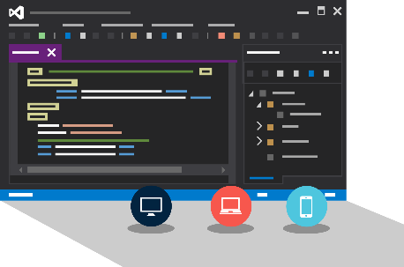
Visual Studio + App Service Web Apps
Create Azure Resources during File / New
Create Web App during deploy
Manage with Server Explorer

Slide 18
WebJobs

Slide 19






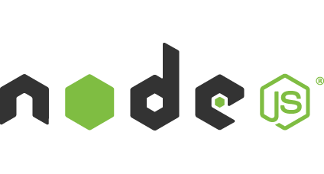

Light-weight CPU Intensive Tasks
run.cmd, run.bat
run.exe
run.ps1
run.sh
run.php
run.py
run.js
Job Type:
On-Demand, Scheduled, Continuous
Scale:
Singleton, Multi-instance
WebJobs SDK Feature:
BlobTrigger, TableTrigger, QueueTrigger, ServicebusTrigger
Deployment:
Portal, Visual Studio, CLI, Git

Slide 20

WebJobs
Web App

Slide 21
WebJobs
Web App

Slide 22
Demo: WebJobs

Slide 23
API Apps

Slide 24
Easily use cloud or custom APIs:
Dozens of built-in APIs for popular SaaS
An ecosystem of APIs for any need
Create and publish custom, reusable APIs
Visual Studio tooling with one click publish and remote debugging
Automatic client SDK generation for many languages
Api Apps
Create, consume and
host APIs more easily

Slide 25
Benefits of API Apps
Bring your API as-is
.NET Web API
Node.js + Express
Java
PHP
Many other technologies
Connect easily to SaaS platforms

Slide 26
API Apps addresses key pains around building and consuming APIs
Build your API
Consume APIs
Web Apps++: Bring you API as is in your language of choice
API discovery
SDK generation
SSO, handled by server
Authentication, built-in to mobile and web SDKs
Expose enterprise APIs
Microservice style
Metadata contract
SSO
Simple access control
Gallery – public & organization

Slide 27
Demo: Creating an API App

Slide 28
Consuming API Apps
API Apps expose HTTP services
Metadata is exposed using Swagger 2.0 metadata
JSON file
Widely supported
Client applications

Slide 29
Enterprise connectivity
Dynamics
SQL
SAP
Oracle

Slide 30




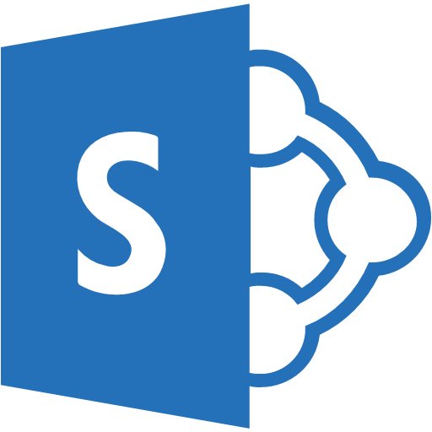

Simplifying Integration
Managed Middle Tier
API App[s]
On Premise Applications
Databases in Azure VMs
SharePoint Online
Cloud-Hosted Web Apps
SSO, Auth, Scale, etc.

Slide 31
Logic Apps

Slide 32
New Logic Apps for easy automation
No code designer for rapid creation
Dozens of pre-built templates to get started
Out of box support for popular SaaS and on-premises apps
Use with custom API apps of your own
Biztalk APIs for expert integration scenarios
LOGIC Apps
Automate SaaS and
on-premises systems

Slide 33
SaaS integration

Slide 34
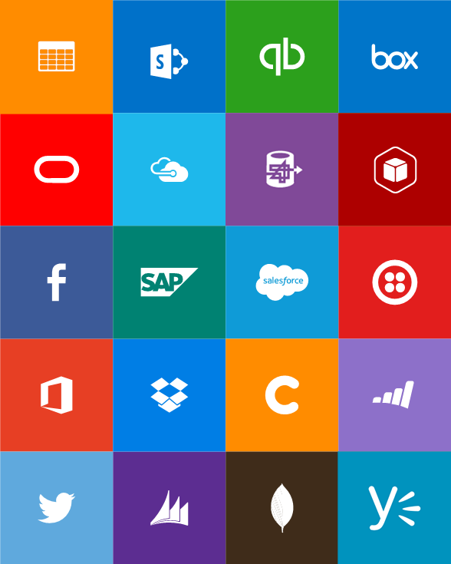
Built-in API Connectors
Connectors
Box
Chatter
Delay
Dropbox
Azure HD Insight
Marketo
Azure Media Services
OneDrive
SharePoint
SQL Server
Office 365
Oracle
QuickBooks
SalesForce
Sugar CRM
SAP
Azure Service Bus
Azure Storage
Timer / Recurrence
Twilio
Twitter
IBM DB2
Informix
Websphere MQ
Azure Web Jobs
Yammer
Dynamics CRM
Dynamics AX
Hybrid Connectivity
Protocols
BizTalk Services
HTTP, HTTPS
File
Flat File
FTP, SFTP
POP3/IMAP
SMTP
SOAP + WCF
Batching / Debatching
Validate
Extract (XPath)
Transform (+Mapper)
Convert (XML-JSON)
Convert (XML-FF)
X12
EDIFACT
AS2
TPMOM
Rules Engine
Notes:
There are already more than 50 API connectors and more added all the time!

Slide 35
Target audience is anyone who can use Azure
… but not necessarily business users or consumers

Slide 36
Mobile Apps

Slide 37
New capabilities for Mobile apps:
Webjobs for long running tasks
CI with TFS/VSO, GitHub, BitBucket
Auto-load balance, Autoscale, Geo DR
Virtual networking and hybrid connections
Site slots for staged deployments
Mobile Apps
Mobile services plus
a whole lot more

Slide 38







Azure Mobile Services
Storage
Authentication
Logic
Push
Scheduler
Notes:
Speaking Notes
Summarize earlier slide
Azure Mobile Services is a Backend-as-a-Service
Instead of you having to design, build, test, deploy, manage, and upgrade your whole backend, we do it for you
Features of Mobile Services
Storage – SQL DB
Authentication – built in support for social providers w/ ability to custom auth
Backend logic – data validation, logical flows, etc
Push Notifications – across all major mobile platforms
Scheduler – backend job processing

Slide 39
Structured Storage
Powered by SQL Database
Supports rich querying capabilities
Dynamic Schematization
Data management in:
Azure Portal
SQL Portal (Silverlight)
SQL Management Studio
REST API
Azure CLI Tools
SQL CLI
Microsoft Azure
Notes:
Speaking points
Mobile Service easily connects to SQL Database
SQL offers rich querying and indexing capabilities
Dynamic Schematization means you don’t have to be a DBA and manage schema
Data can be managed in:
Azure Portal (read and delete data)
SQL Portal (Silverlight)
SQL Management Studio (windows)
REST API (used by SDKs)
Azure CLI tools
SQL CLI (Node module)

Slide 40
Server Side Table Scripts
Node.js scripts
.NET Web API
backend in
Visual Studio
Passes through to SQL by default
MongoDB, Table Storage, SQL out of the box
Intercept CRUD requests to tables
Fully customizable
Notes:
Speaking points
Node backend generates Node scripts for each table action
Scripts intercept CRUD requests
Pass to SQL by default
Custom logic added here
Edit in portal (NODE)
.NET Backend creates Visual Studio project

Slide 41
Demo: Basic Mobile App with Validation

Slide 42
Custom API
Non-table based endpoints
Accessible from
GET
POST
PUT
PATCH
DELETE
For node.js logic in scripts like table endpoints
For .NET delivered through a WebAPI
Expose any functionality you want
Microsoft Azure
Notes:
Speaking points
All scripts so far tied to a table action
Custom APIs are non-table based endpoints
Script functionality for normal HTTP methods

Slide 43
Continous Delivery with App Service

Slide 44
Continuous integration

Slide 45

Continuous Deployment for Web Apps
Web App Production Slot
Agility through Continuous Deployment
Auto-Swap
Hooks
Git pull
Commits
Changes
Web App Staging Slot
Source Control / Code Repo
Developer

Slide 46

Source Control for Web/API/Mobile Apps
Git
Visual Studio
Online
CodePlex
GitHub
BitBucket
DropBox
FTP
Choose your own adventure!
Notes:
Slide Objectives:
Objective #1
Transition:
Transition statement(s) to setup the slide
Speaking Points:
Speaking Point #1
Speaking Point #2
Notes:
Any notes go here

Slide 47
AutoScale

Slide 48
AutoScale
Web App

Slide 49
AutoScale
Web App

Slide 50
AutoScale
Web App

Slide 51
App Service Environment

Slide 52
App Service Environment (ASE)
New Premium Tier Feature
Dedicated compute resources and network resources
Increased Scaling Options
Directly created in a Virtual Network
Support all Web App features and capabilities
Support Web, Mobile and API Apps
Global Scale
Notes:
An App Service Environment provides a fully isolated and dedicated environment for securely running all of your apps including Web Apps, Mobile Apps, API Apps and Logic Apps. An App Service Environment is always created inside of a regional virtual network. This enables apps to securely connect to other endpoints accessible only inside of a virtual network, including endpoints connected via Site-to-Site and ExpressRoute connections. It also enables an App Service Environment to be secured behind upstream appliances, firewalls and network SaaS providers.
Apps running in an App Service Environment also have even more scaling options, including the ability to run on up to fifty (50) compute instances and the new P4 compute resource.

Slide 53
Conceptual Model
App Service Plan
App Service Plan
App Service App
App Service App
App Service App
App Service App
App Service App
App Service App
SKU: Premium (# of sites, storage, slots…)
Compute Resource: P4 ( 8 cores, 14 GB memory)
Scale: 8
SKU: # of sites, storage, slots…
Compute Resource: cores, memory
Scale: number of instances
Note: For App Service Environment the SKU will always be Premium
Notes:
Speaker notes:
Explain how ASE differ from multi-tenant App Service using App Service Plan.

Slide 54
Application Insights

Slide 55
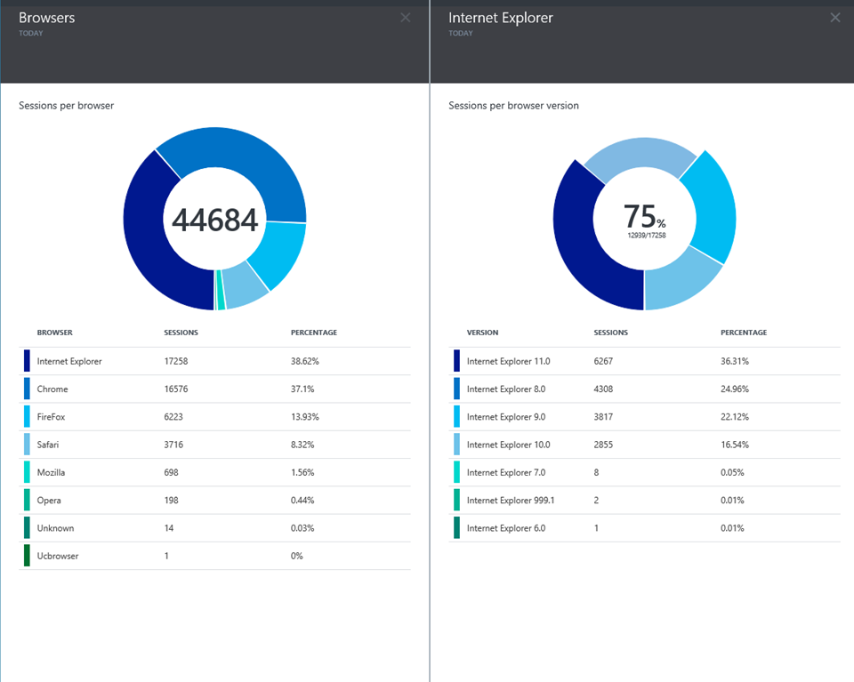
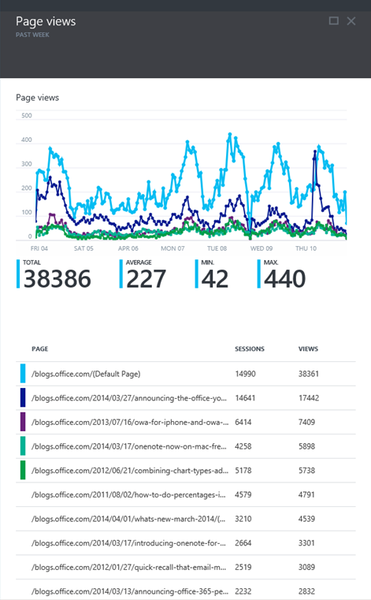
Application Insights
Application Insights

Slide 56
Try App Service: Web Apps today
https://tryappservice.azure.com
Ask Questions:
Twitter:
Email
Public forum:

Slide 57
Q&A

Slide 58


Get started
Visit azure.microsoft.com and provision your first web app for free
Visit VisualStudio.com to start up a VSO instance & download a trial of VS Enterprise
If you already have VS Enterprise, go try IntelliTrace and IntelliTest on your solutions today

